Slide 1
Lagrange Method of Interpolation

Slide 2
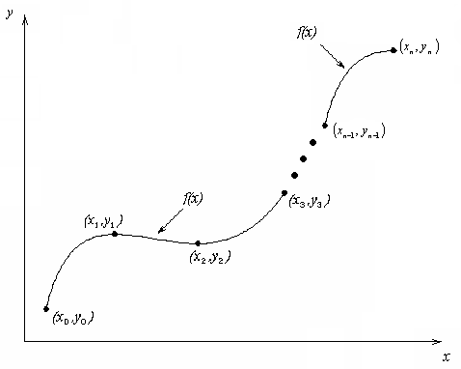
What is Interpolation ?
Given (x₀,y₀), (x₁,y₁), …… (x_{n},y_{n}), find the value of ‘y’ at a value of ‘x’ that is not given.

Slide 3

Interpolants
Polynomials are the most common choice of interpolants because they are easy to:
  Evaluate
  Differentiate, and
  Integrate.

Slide 4
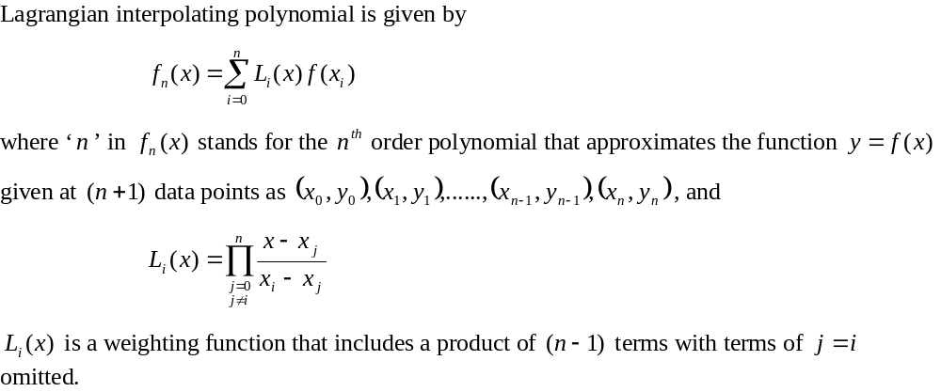
Lagrangian Interpolation

Slide 5
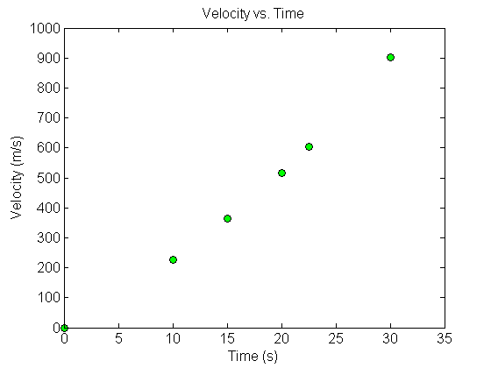



Example
The upward velocity of a rocket is given as a function of time in Table 1. Find the velocity at t=16 seconds using the Lagrangian method for linear interpolation.
Table Velocity as a
function of time
(s) | (m/s)
0 | 0
10 | 227.04
15 | 362.78
20 | 517.35
22.5 | 602.97
30 | 901.67
Figure. Velocity vs. time data
for the rocket example

Slide 6
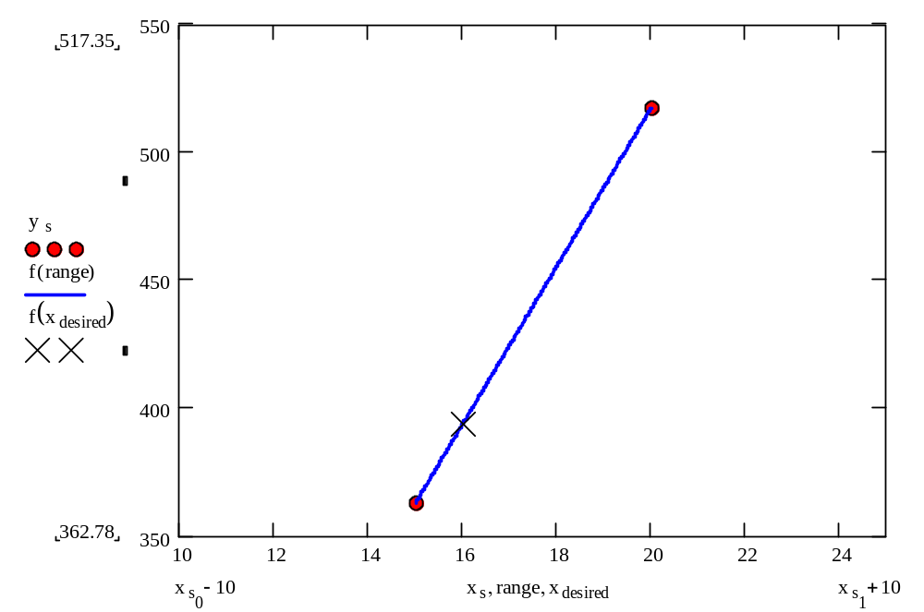
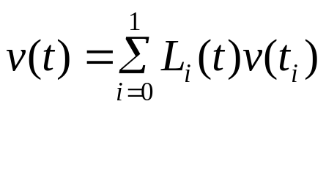

Linear Interpolation

Slide 7
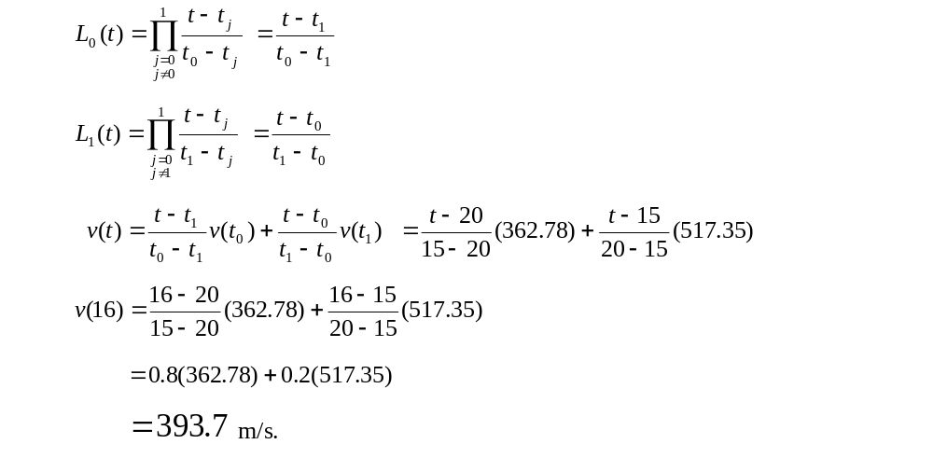
Linear Interpolation (contd)

Slide 8
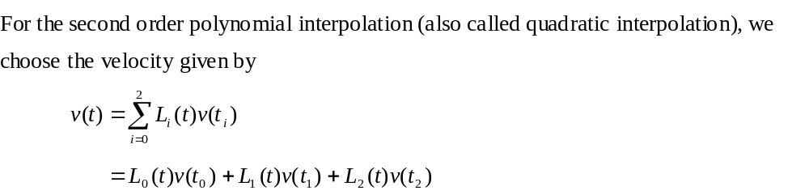
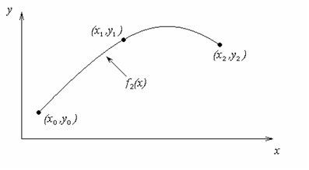
Quadratic Interpolation

Slide 9
Example
The upward velocity of a rocket is given as a function of time in Table 1. Find the velocity at t=16 seconds using the Lagrangian method for quadratic interpolation.
Table Velocity as a
function of time
(s) | (m/s)
0 | 0
10 | 227.04
15 | 362.78
20 | 517.35
22.5 | 602.97
30 | 901.67
Figure. Velocity vs. time data
for the rocket example

Slide 10
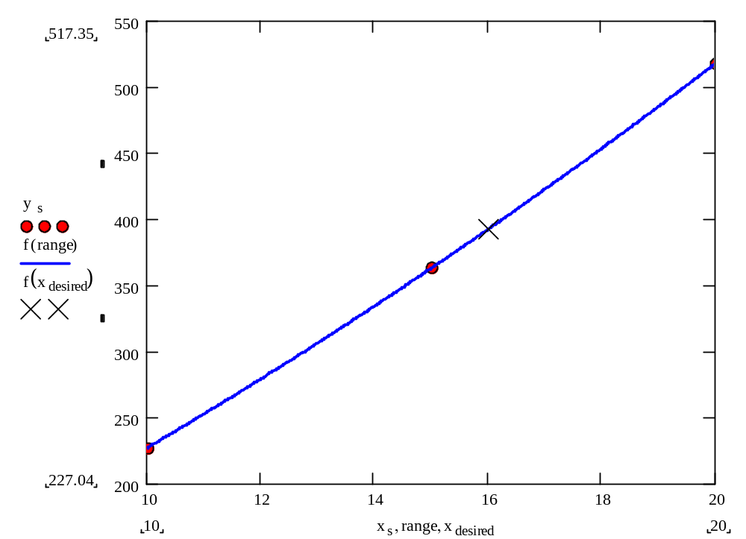
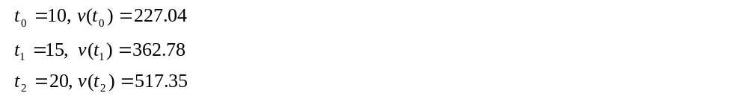
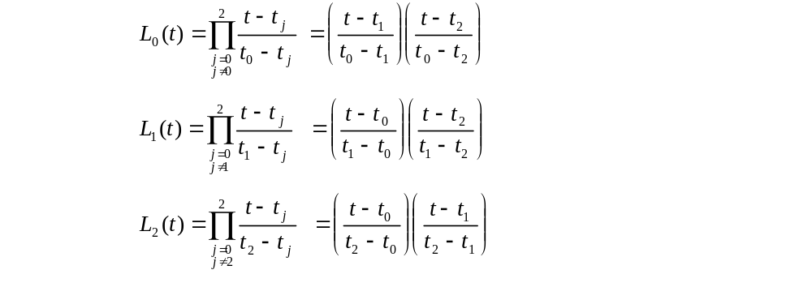
Quadratic Interpolation (contd)

Slide 11
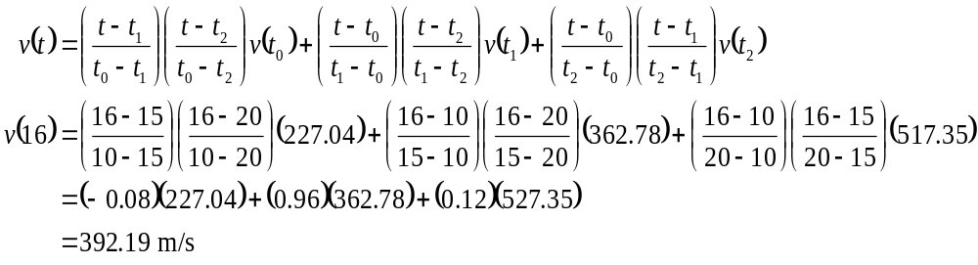

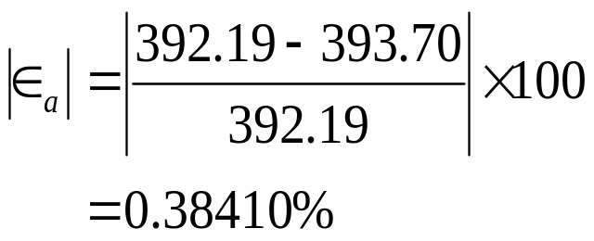
Quadratic Interpolation (contd)
The absolute relative approximate error obtained between the results from the first and second order polynomial is

Slide 12
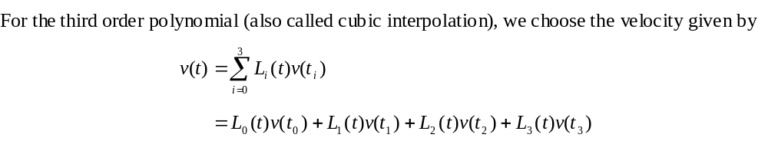
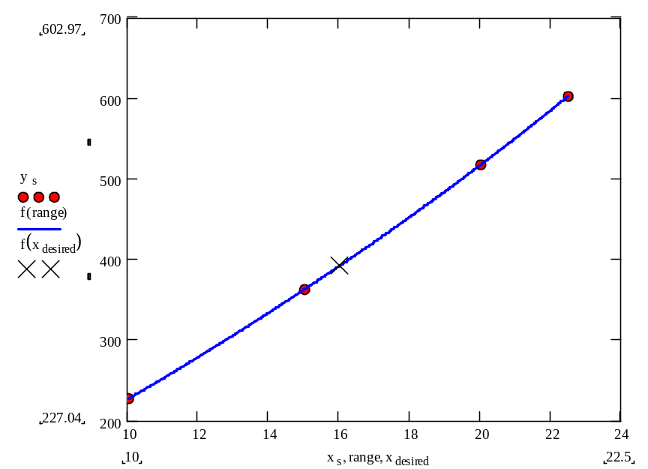
Cubic Interpolation

Slide 13
Example
The upward velocity of a rocket is given as a function of time in Table 1. Find the velocity at t=16 seconds using the Lagrangian method for cubic interpolation.
Table Velocity as a
function of time
(s) | (m/s)
0 | 0
10 | 227.04
15 | 362.78
20 | 517.35
22.5 | 602.97
30 | 901.67
Figure. Velocity vs. time data
for the rocket example

Slide 14
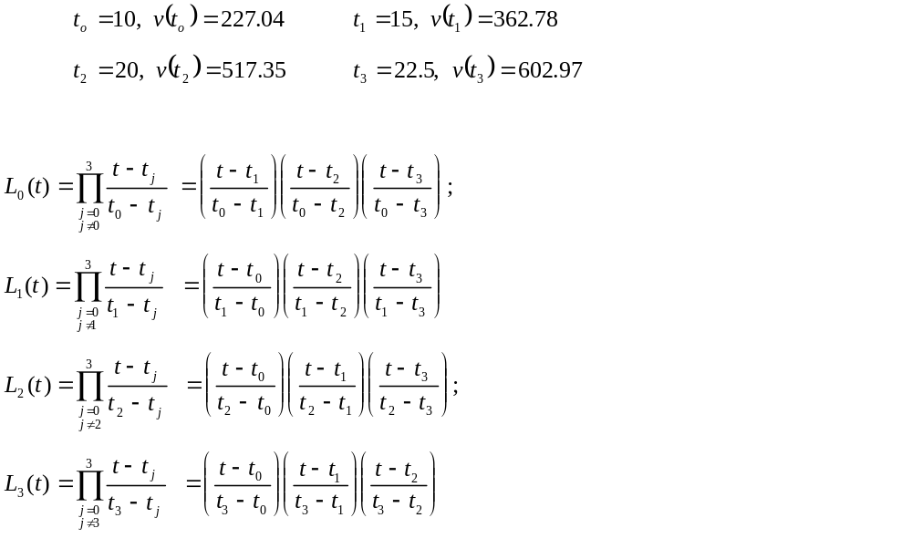
Cubic Interpolation (contd)

Slide 15
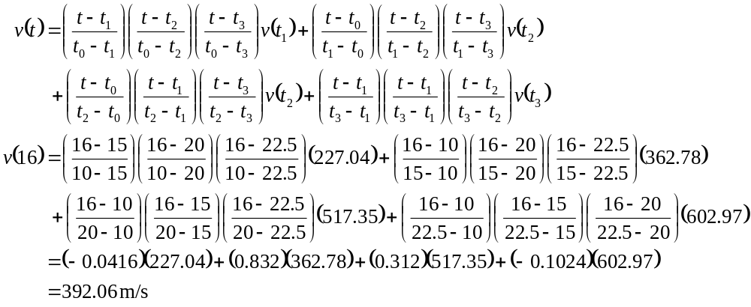
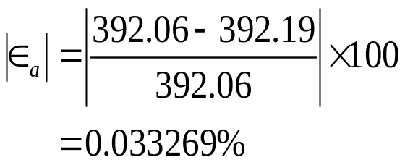
Cubic Interpolation (contd)
The absolute relative approximate error obtained between the results from the first and second order polynomial is

Slide 16
Comparison Table
Order of Polynomial | 1 | 2 | 3
v(t=16) m/s | 393.69 | 392.19 | 392.06
Absolute Relative Approximate Error | -------- | 0.38410% | 0.033269%

Slide 17
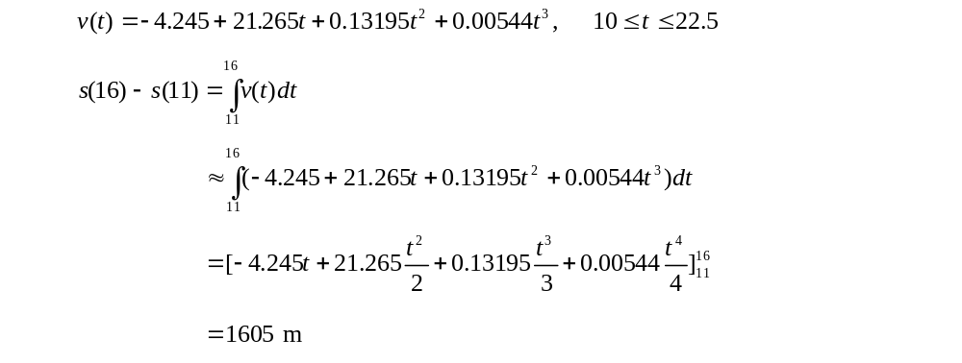
Distance from Velocity Profile
Find the distance covered by the rocket from t=11s to
t=16s ?

Slide 18
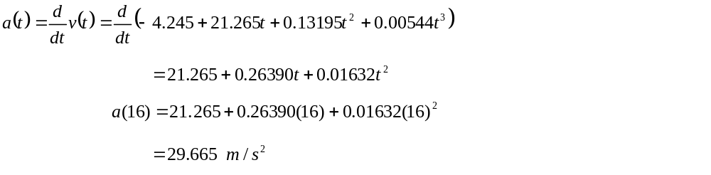
Acceleration from Velocity Profile
Find the acceleration of the rocket at t=16s given that
,

Slide 19
THE END

